Slide 1
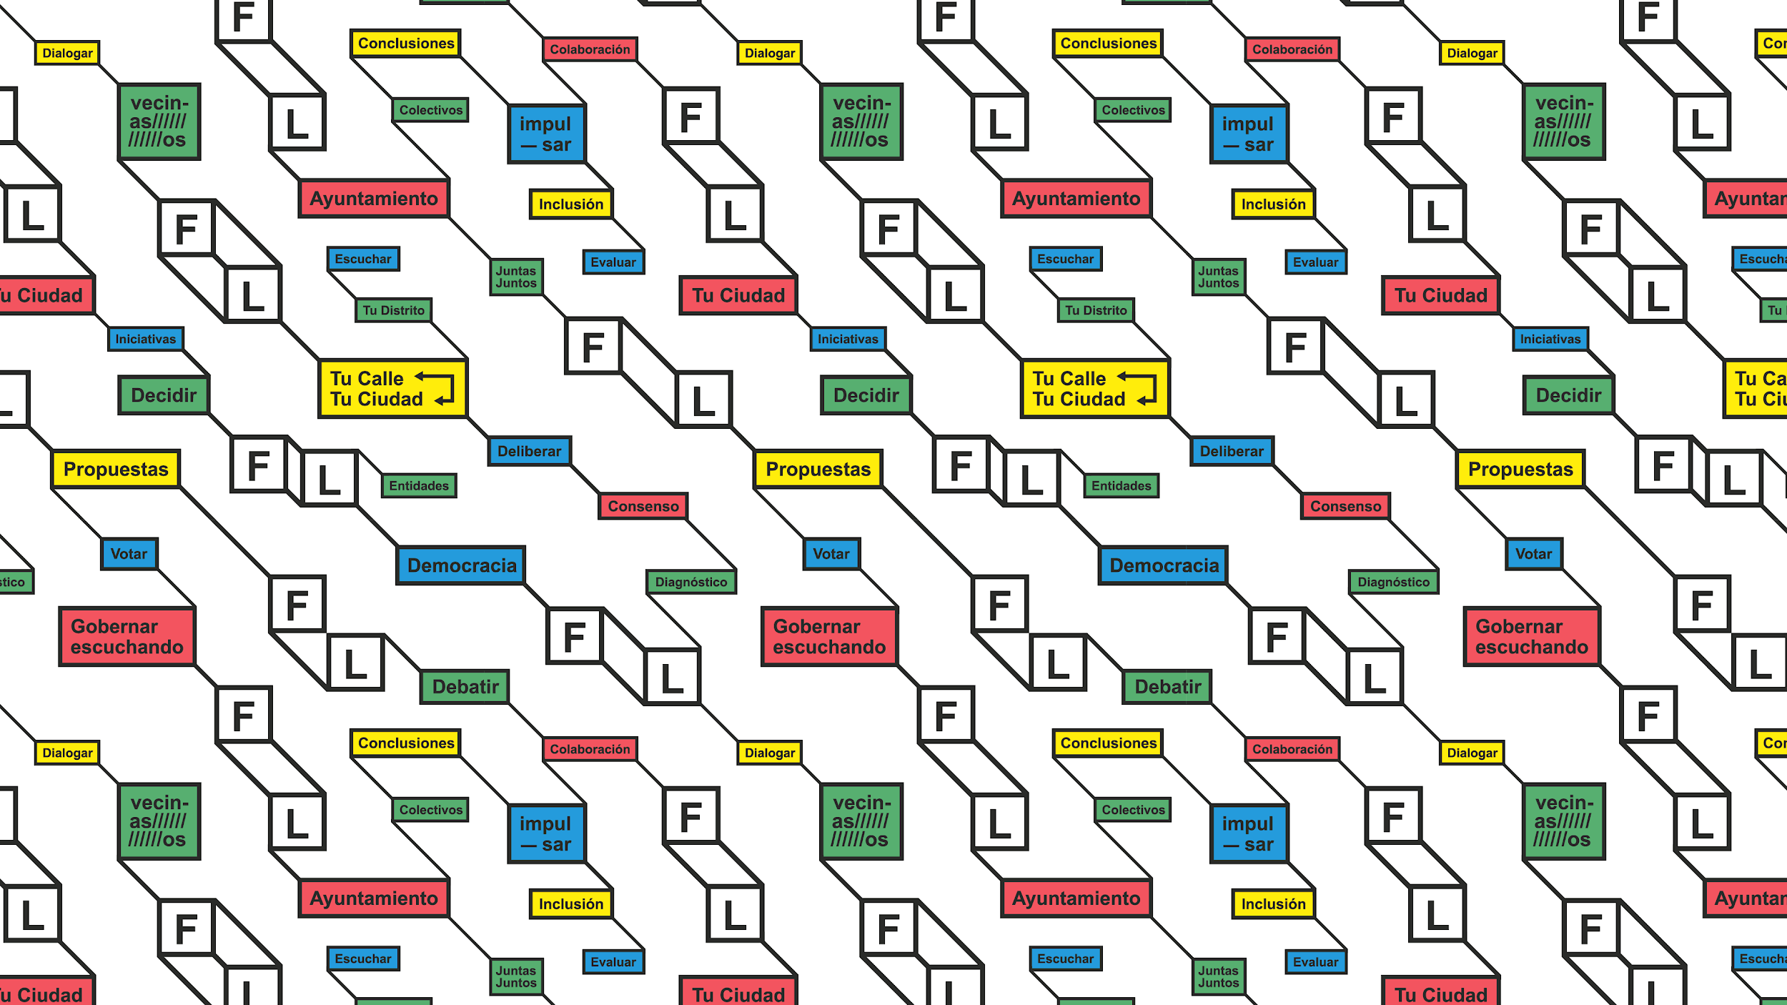

Crowdsourcing for Public Policymaking
Analyzing Decide Madrid Data using NLP
Ori Pleban
June 20, 2019

Slide 2

Roadmap
Background
Problem
Approach
Future Vision
Questions

Slide 3
Background - Stages of Policymaking
Agenda Setting
More information
Evaluation
Problem Definition
Greater accountability
Accelerated innovation
Implementation
Solution Definition
Increased effectiveness
Enhanced transparency

Slide 4
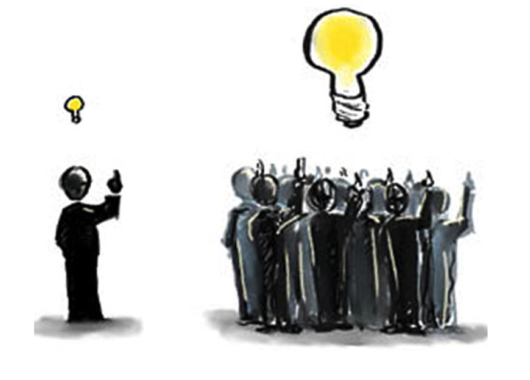
Background - Crowdsourcing
Crowdsourcing is an open call for anybody to participate in an online task. It’s widely used as a knowledge search and problem-solving method in the public and private sector.
Notes:
Crowdsourcing means an open call for anybody to participate in an online task. Crowdsourcing was initially coined as a term to describe a new method for businesses to source solutions and work from an online crowd instead of designated contractors and experts. Crowdsourcing is now widely used as a knowledge search and problem solving method in several realms, including crowdsourced research and design, journalism, design, citizen science, and crisis management.
Crowdsourcing can be applied in several parts of a policymaking cycle
Role of crowdsourcing in policymaking
Crowdsourcing is an open call for anybody to participate in an online task.
Crowdsourcing is widely used to source solutions in the private sector and more often in the public sector
Through crowdsourcing, policymakers have access to a large number of knowledge sources.

Slide 5
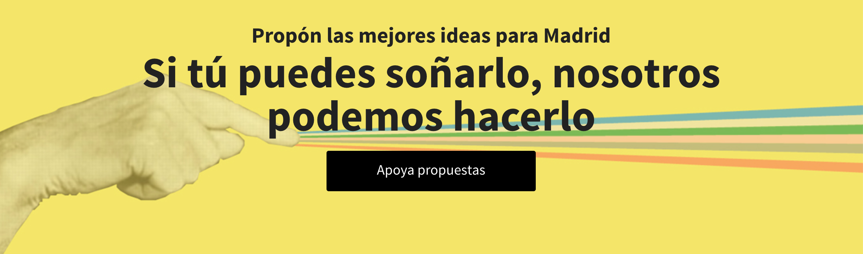
Background - Citizen Participation in Madrid
Participatory Initiatives in Madrid
Decide Madrid
Participatory Budgeting
Local Forums
Citizen Observatory
G-1000
Co-Design of Libraries

Slide 6

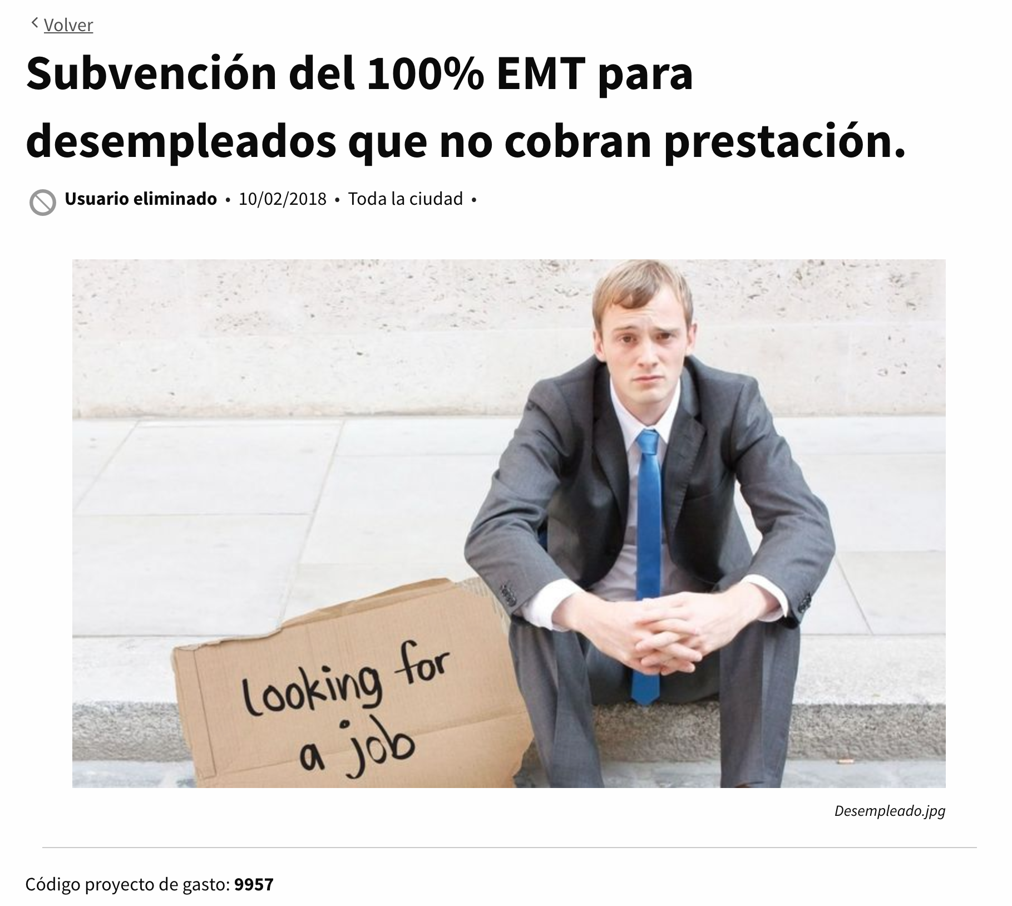
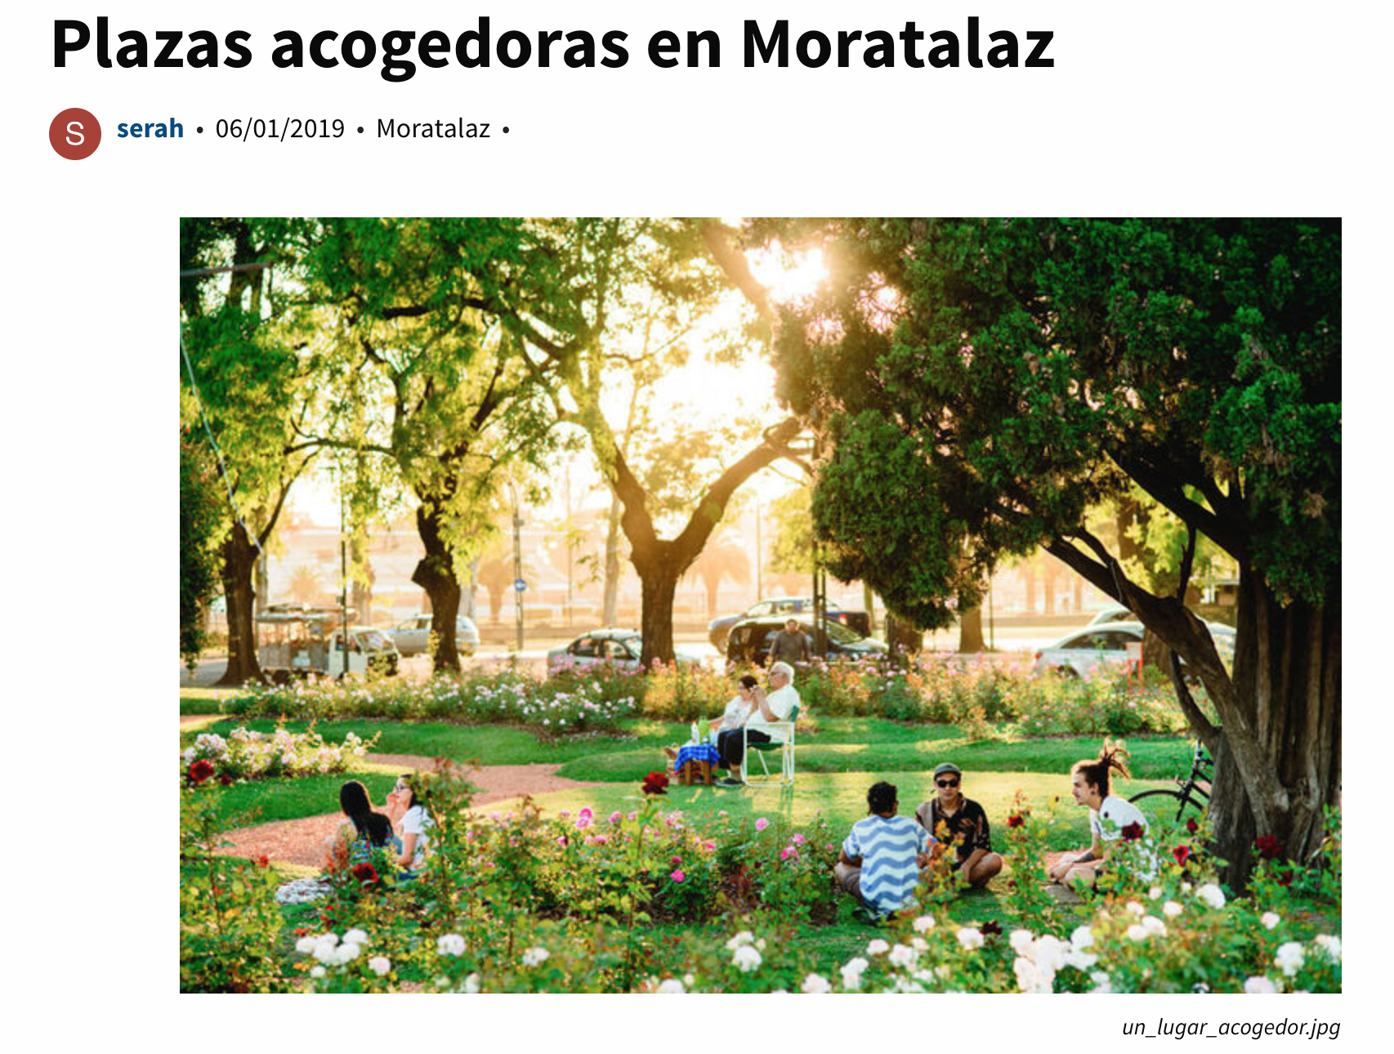
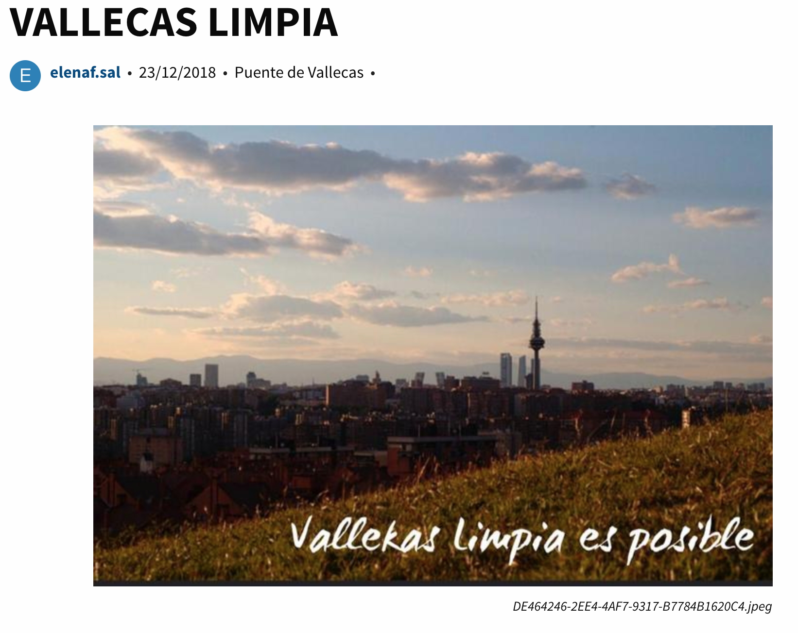
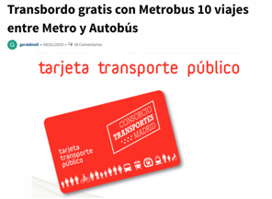
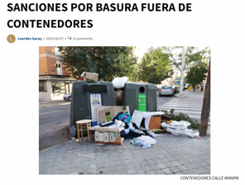
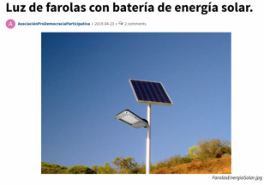
Background - Participatory Budgeting
Notes:
Participatory Democracy platform

Slide 7
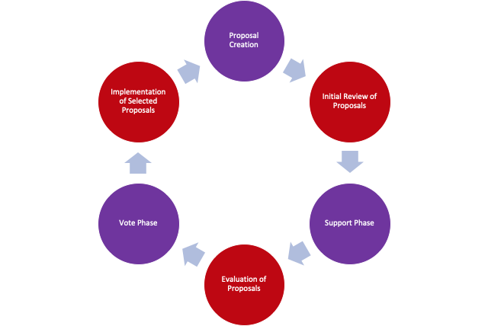
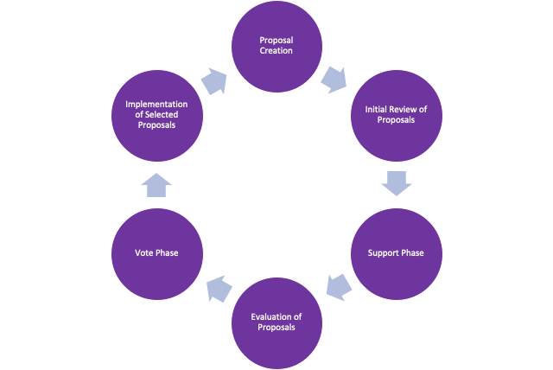
Problem - Participatory Budget Process

Slide 8
Problem - Participatory Budget Process

Slide 9
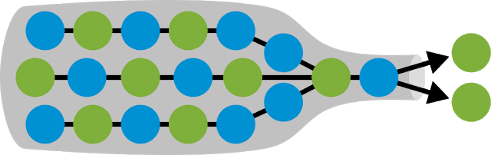
Problem
City officials spend significant effort manually reviewing and evaluating citizen budget proposals. It isn’t feasible for them to evaluate each and every proposal.
How can Madrid (and other local governments) make sense of and gain insight from crowdsourced budget proposals during the process?

Slide 10
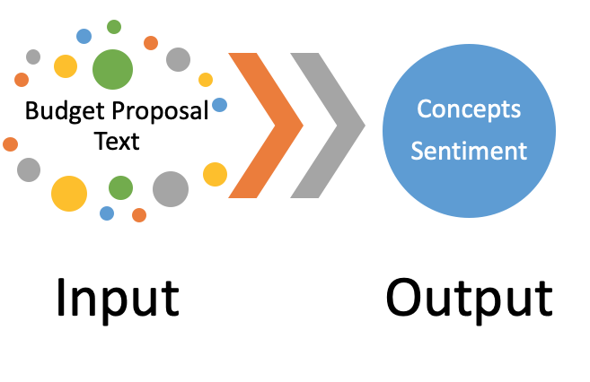
Approach - NLP
Notes:
Natural Language Processing (NLP) - A branch of artificial intelligence that deals with the interaction between computers and humans using the natural language
NLP can be used to widen the bottleneck and help policymakers make sense of large amounts of unstructured, crowdsourced data

Slide 11
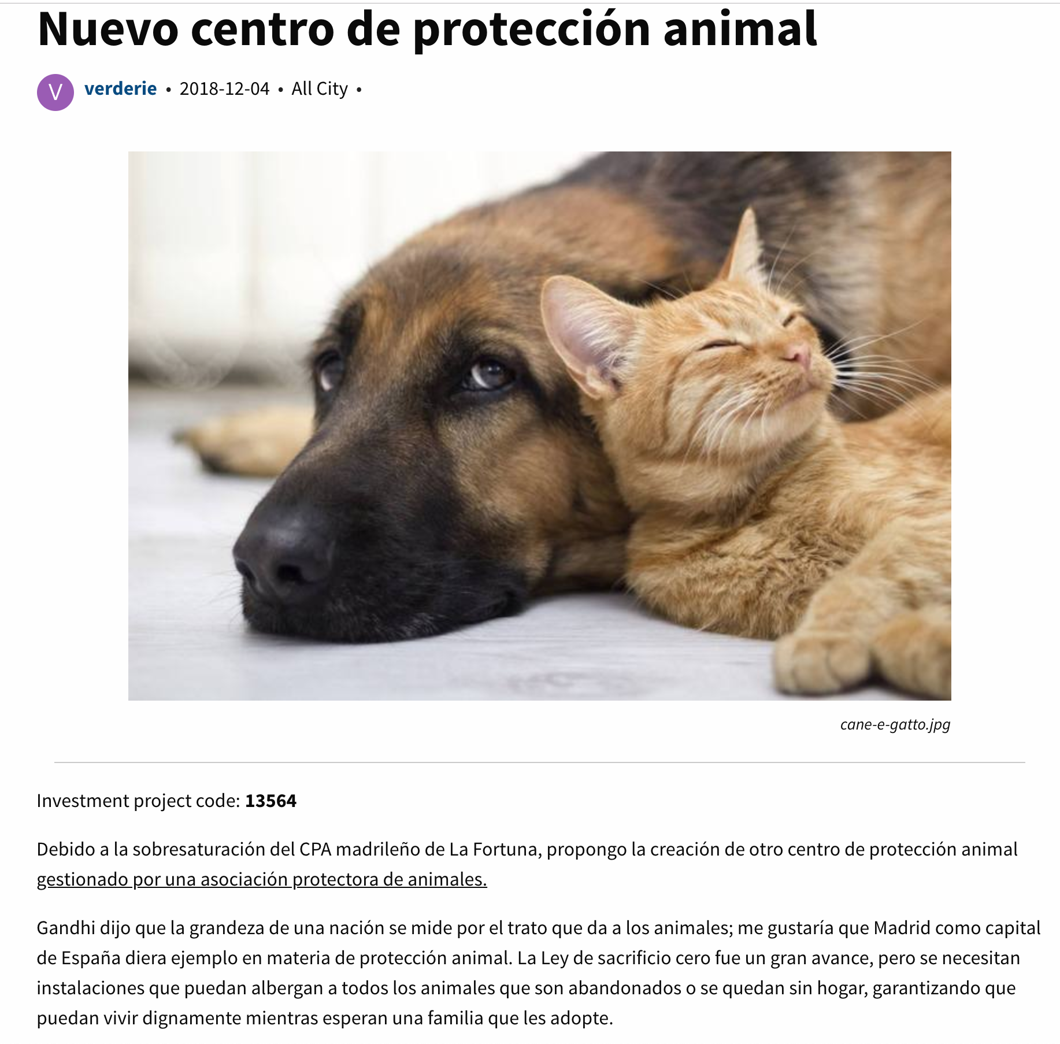
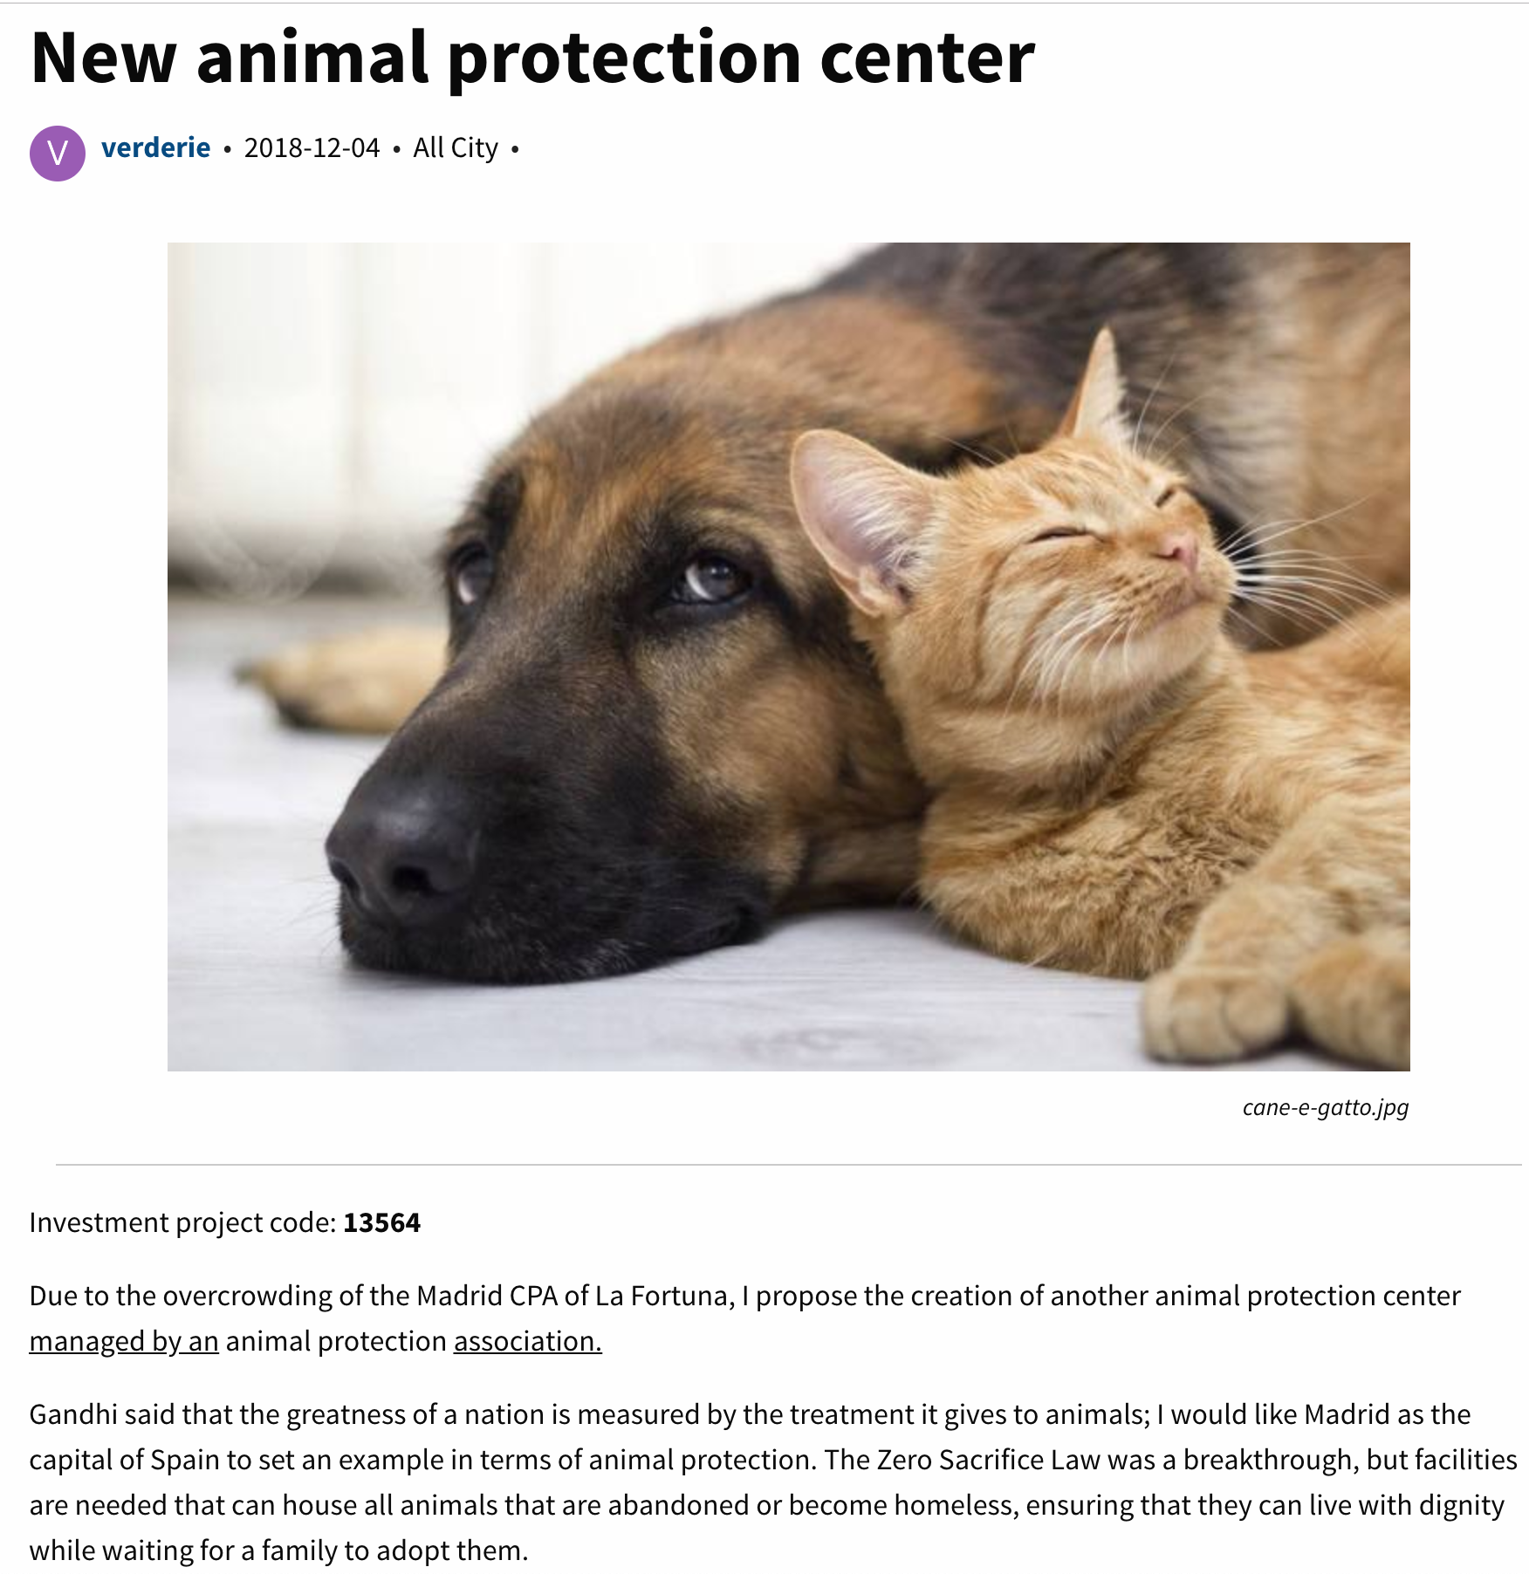
Approach - NLP
Proposal Title
Description
Notes:
Natural Language Processing (NLP) - A branch of artificial intelligence that deals with the interaction between computers and humans using the natural language
NLP can be used to widen the bottleneck and help policymakers make sense of large amounts of unstructured, crowdsourced data

Slide 12

Approach - NLP - Bag of Words
Notes:
Natural Language Processing (NLP) - A branch of artificial intelligence that deals with the interaction between computers and humans using the natural language
NLP can be used to widen the bottleneck and help policymakers make sense of large amounts of unstructured, crowdsourced data

Slide 13
Approach - NLP - Bag of Words
Due to the overcrowding of the Madrid CPA of La Fortuna, I propose the creation of an animal protection center managed by an animal protection association.
Due to the overcrowding of the Madrid CPA of La Fortuna, I propose the creation of an animal protection center managed by an animal protection association.
Tokenize and remove stop words
Remove punctuation
due, overcrowding, madrid, cpa, la, fortuna, propose, creation, animal, protection, center, managed, animal, protection, association
Notes:
Natural Language Processing (NLP) - A branch of artificial intelligence that deals with the interaction between computers and humans using the natural language
NLP can be used to widen the bottleneck and help policymakers make sense of large amounts of unstructured, crowdsourced data

Slide 14
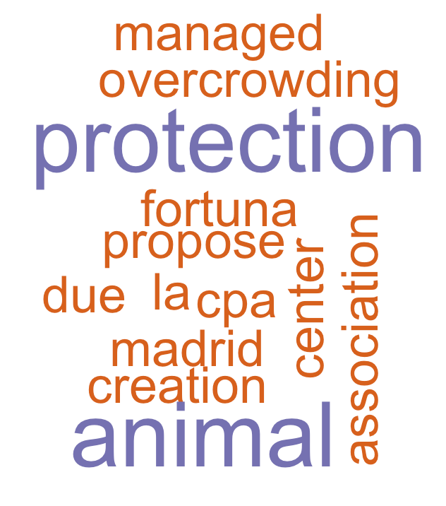
Approach - NLP - Bag of Words
due - 1
overcrowding - 1 madrid - 1
cpa - 1
la - 1
fortuna - 1
propose - 1
creation - 1
animal - 2
protection - 2
center - 1
managed - 1
protection - 1
association - 1
Notes:
Natural Language Processing (NLP) - A branch of artificial intelligence that deals with the interaction between computers and humans using the natural language
NLP can be used to widen the bottleneck and help policymakers make sense of large amounts of unstructured, crowdsourced data
Term Frequency: is a scoring of the frequency of the word in the current document
Inverse Document Frequency: is a scoring of how rare the word is across documents

Slide 15
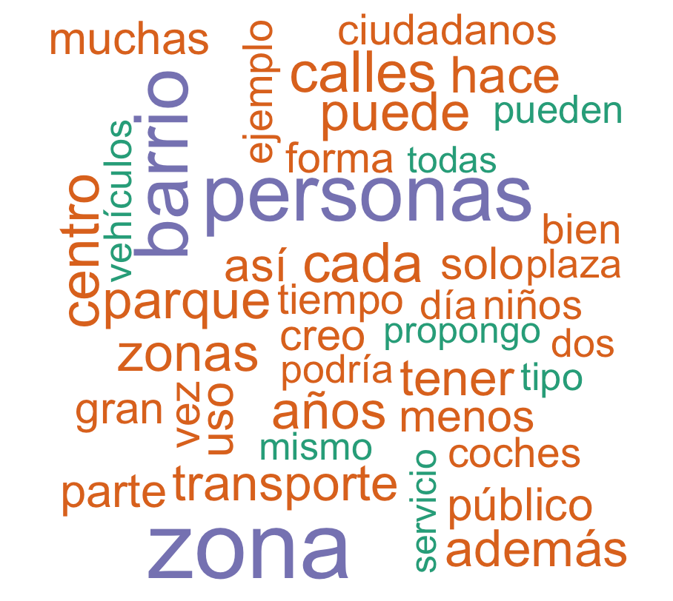
Approach - NLP - Bag of Words
calle - 6722
zona - 6721
personas - 5592
ciudad - 5572
barrio - 5123
ayuntamiento - 4592
vecinos - 3822
calles - 3719
centro - 3574
cada - 3567
puede - 3439
parque- 3435
zonas - 3352
...
25,000+ proposals
Notes:
Natural Language Processing (NLP) - A branch of artificial intelligence that deals with the interaction between computers and humans using the natural language
NLP can be used to widen the bottleneck and help policymakers make sense of large amounts of unstructured, crowdsourced data
Other things we can do to the text
Stem the words
N-grams - two word phrases

Slide 16
Approach - NLP
What can we do with our bag of words?
Use topic modeling to recognize major concepts and topics in proposals
Categorize proposals and identify which departments or entities should review proposals
Assess how residents talk about each topic using sentiment analysis
Notes:
Topic Modeling
A tool for discovering the thematic structure in large archives of text. It seeks to infer topic structure given known documents and word.
Text Categorization
Sentiment Analysis
separate each proposal description into words, filter out tokens which are purely numbers, remove stop words, and stem each token to its root form
Produces dataset with one-term-per-document-per-row
Turn that into document term matrix
tf-idf is intended to measure how important a word is to a document in a collection (or corpus) of documents
find the important words for the content of each document by decreasing the weight for commonly used words and increasing the weight for words that are not used very much in a collection or corpus of documents
term frequency and inverse document frequency allows us to find words that are characteristic for one document within a collection of documents

Slide 17
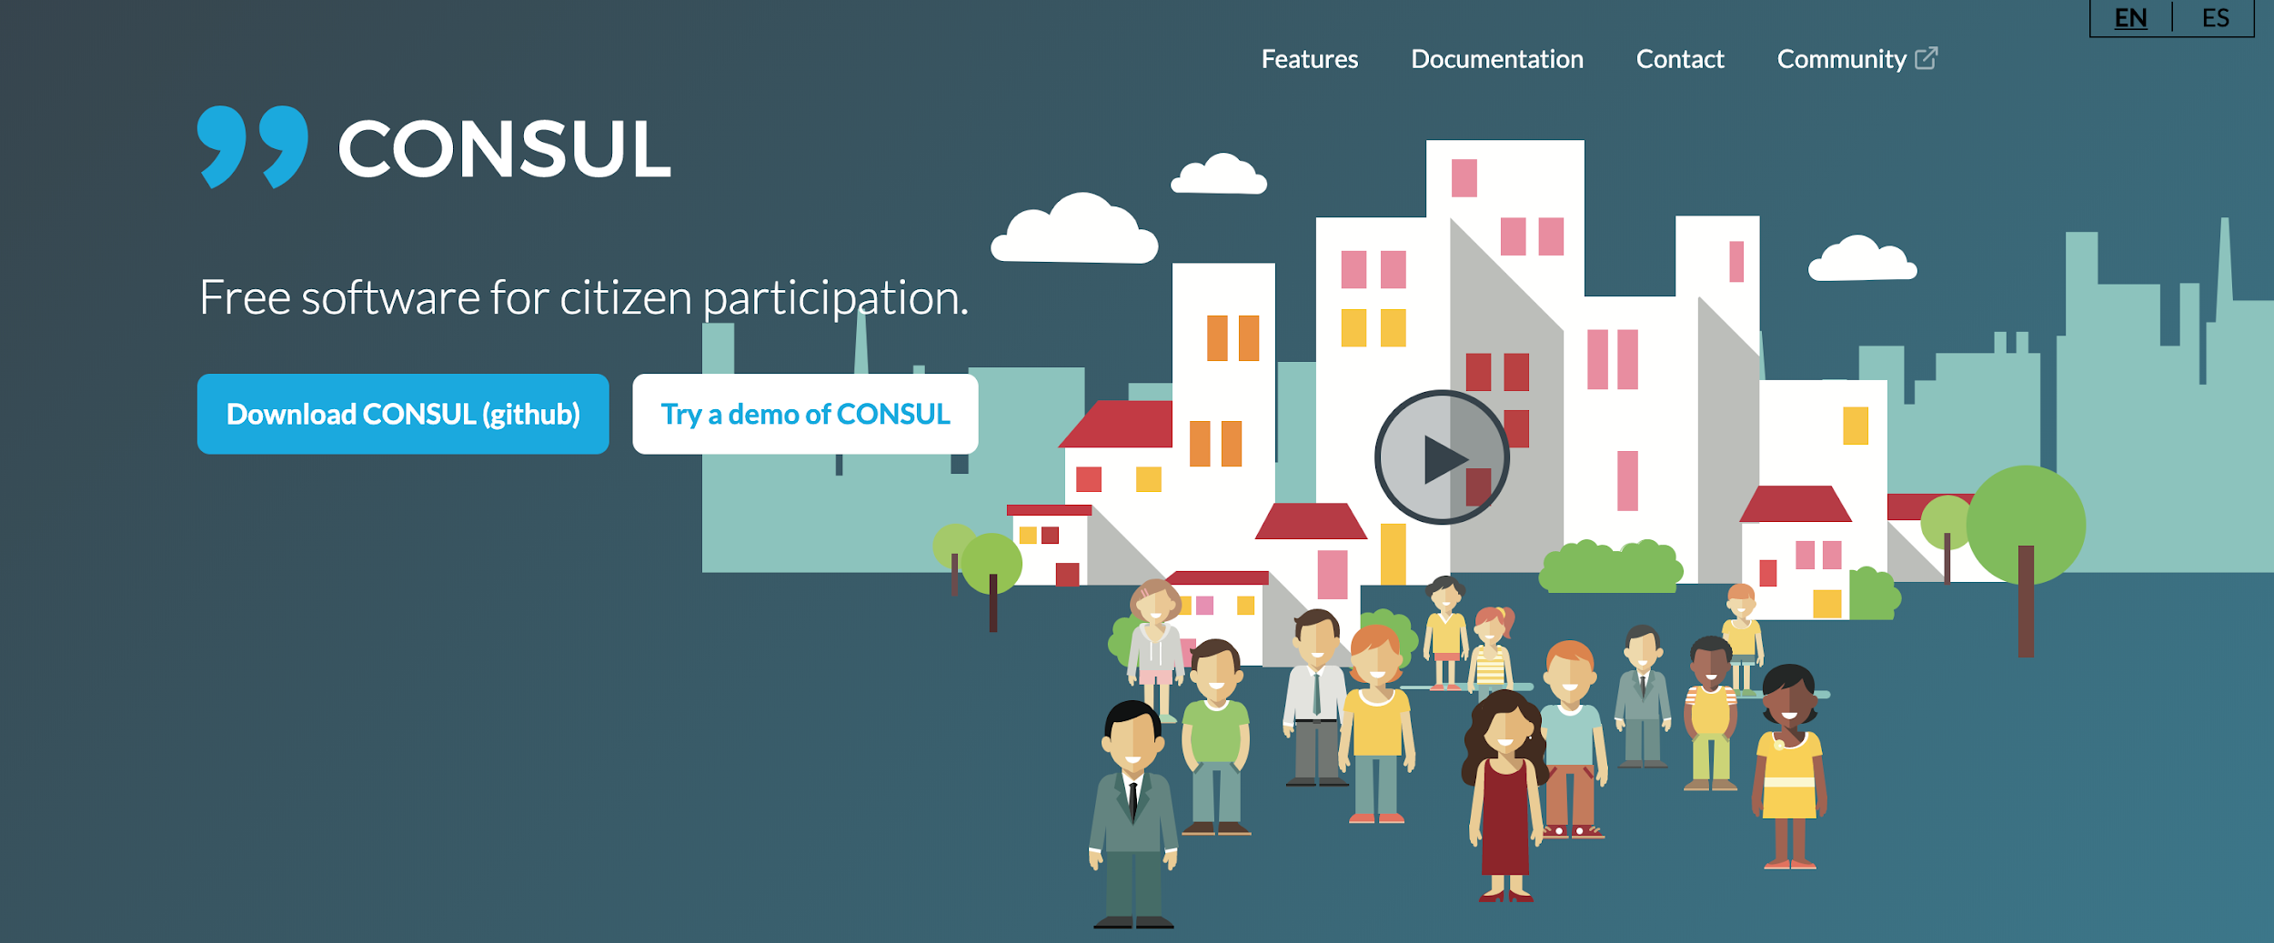
Conclusion - Future vision

Slide 18




Questions
GitHub Repo: https://github.com/opleban/decide_madrid_text_analysis

